Slide 1
To Ionise or not to ionise?i
CH₃COOH (aq)
NaCl (s)
NaOH (aq)
Zn (s)
ZnCl₂ (aq)
HNO₃ (aq)
H₂CO₃ (aq)
CaCO₃ (s)

Slide 2
Write a molecular, total ionic and net ionic equation for…
The addition of magnesium chloride solution to silver nitrate solution produces a solid precipitate of silver chloride.

Slide 3
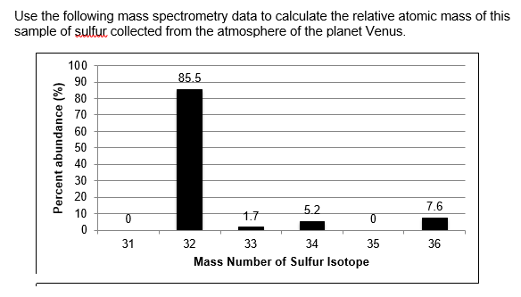

Slide 4
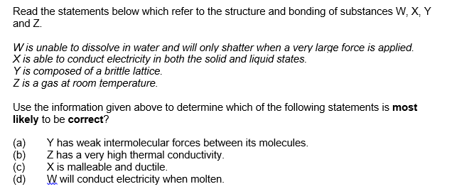

Slide 5
A1 Chemistry
Exothermic and endothermic reactions

Slide 6
Learning intentions
chemical reactions and phase changes involve enthalpy changes, commonly observable as changes in the temperature of the surroundings and/or the emission of light
endothermic and exothermic reactions can be explained in terms of the Law of Conservation of Energy and the breaking of existing bonds and forming of new bonds; heat energy released or absorbed by the system to or from the surroundings, can be represented in thermochemical equations

Slide 7
Success criteria
Draw energy profile diagrams for endothermic and exothermic reactions (generic or from equations)
Identify H as + for endothermic and – for exothermic
Interpret energy profile diagrams to find H

Slide 8
Key words
enthalpy
endothermic
exothermic

Slide 9
Conservation of energy
Chemical energy may be converted from one form to another, but the total amount of energy remains constant.
Chemical energy can be kinetic (motion energy) or potential (position energy).

Slide 10
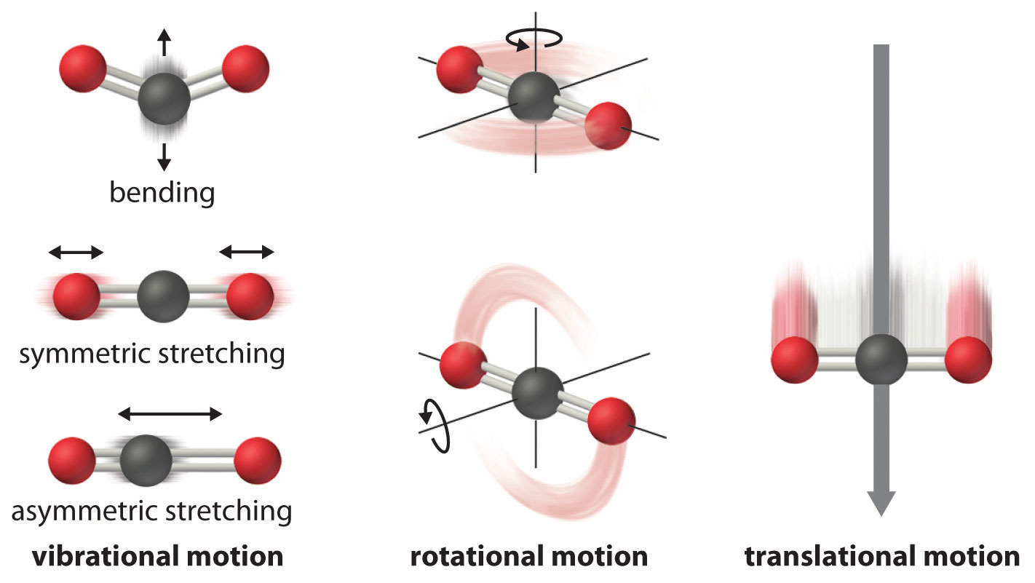

Slide 11
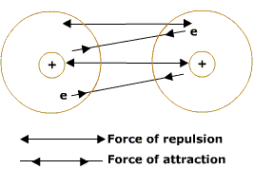

Slide 12
enthalpy
All substances contain a quantity of chemical potential energy, which is stored in bonds within and between atoms or ions.
Enthalpy is a measure of the energy per mole of each substance (as a heat equivalent in Joules, J)
Given the symbol H

Slide 13
ΔH
Change in enthalpy indicates whether energy is absorbed or released in a reaction.
ΔH = Enthalpy of products – enthalpy of reactants

Slide 14
exoThermic reactions
If the enthalpy of the reactants is greater then the enthalpy of the products, energy will be released as heat.
ΔH is negative

Slide 15
endothermic reactions
If the enthalpy of the products is greater than the enthalpy of the reactants, heat energy will be absorbed.

Slide 16
ENDOTHERMIC
If the enthalpy of the products is greater than the reactants
ΔH is positive.

Slide 18
Heat iheat in equations
H2(g) + F2(g) = 2 HF(g) ΔH = -542 kJ/equation
H2(g) + F2(g) = 2 HF(g) + 542 kJ

Slide 19
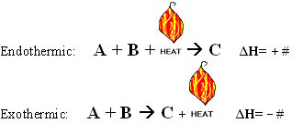

Slide 20
Success criteria
Draw energy profile diagrams for endothermic and exothermic reactions (generic or from equations)
Identify H as + for endothermic and – for exothermic
Interpret energy profile diagrams to find H

